Slide 1
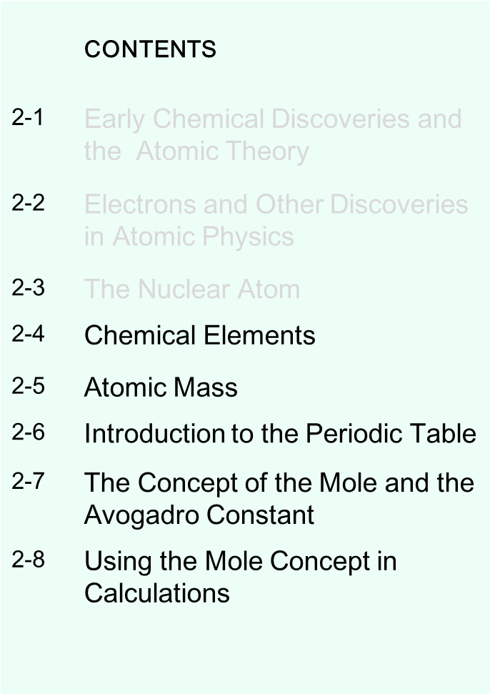
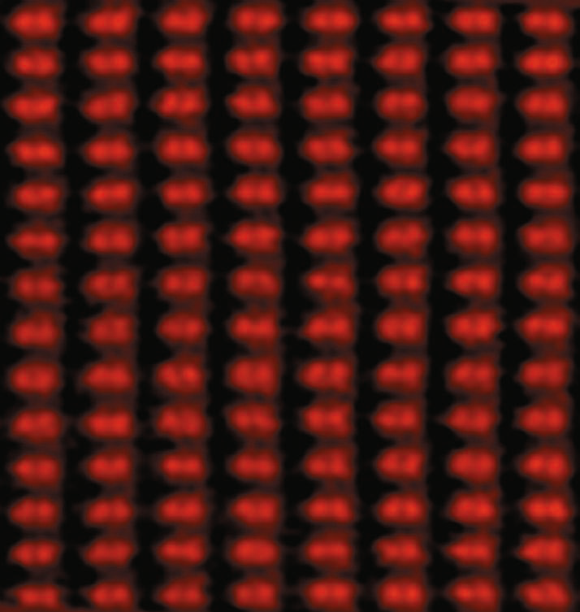
Atoms and the Atomic Theory
General Chemistry: Chapter 2
Copyright © 2011 Pearson Canada Inc.
Notes:
Chemistry 140 Fall 2002
Image of silicon atoms that are only 78 pm apart; image produced by using a
scanning transmission electron microscope (STEM). The hypothesis that all matter is
made up of atoms has existed for more than 2000 years. It is only within the last few
decades, however, that techniques have been developed that can render individual
atoms visible.

Slide 2
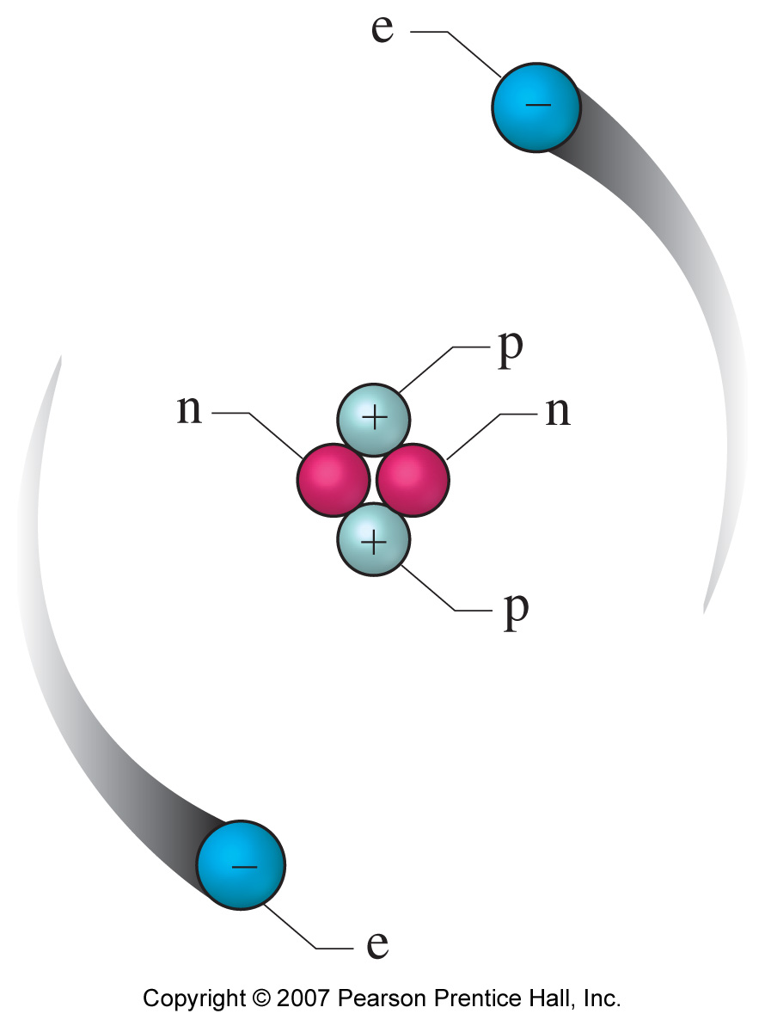
Nuclear Atom
Small nucleus that contains almost all the mass and is positively charged:
protons (positive charge) and neutrons (neutral)
Rutherford
protons 1919
Atomic mass number (A) = protons + neutrons
James Chadwick
neutrons 1932
Electrons outside the nucleus with almost no mass and equal negative charge to the positive charge of the nucleus
What distinguishes one element from another is the number of protons (Atomic number (Z))
Copyright © 2011 Pearson Canada Inc.

Slide 3
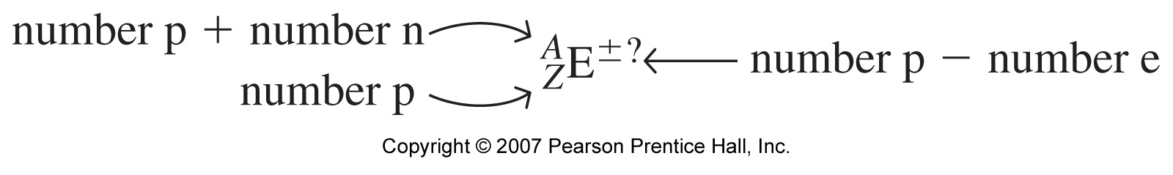
2-4 Chemical Elements
To represent a particular atom we use symbolism:
symbol of the element
A= mass number = protons + neutrons
Z = atomic number = protons
General Chemistry: Chapter 2
Copyright © 2011 Pearson Canada Inc.
Notes:
Chemistry 140 Fall 2002
Often do not specify Z when writing. For example ¹⁴C, C specifies Z = 12.
Special names for some isotopes. For example hydrogen, deuterium, tritium.

Slide 4
Chemical Elements
To represent a particular atom we use symbolism:
symbol of the element
* Ion has net charge: when p is not equal to e
General Chemistry: Chapter 2
Copyright © 2011 Pearson Canada Inc.
Notes:
Chemistry 140 Fall 2002
Often do not specify Z when writing. For example ¹⁴C, C specifies Z = 12.
Special names for some isotopes. For example hydrogen, deuterium, tritium.

Slide 5
Isotopes
Distinguishing feature of atoms is the number of protons or the atomic number (Z)
Masses of atoms of the same element sometimes can vary
Isotopes are atoms with the same Z (i.e., same element) but with different atomic mass (the mass must be determined experimentally)
The most abundant element is C, and its most abundant isotope, C-12 (or ¹²C), is designated as the standard of atomic mass
¹/₁₂ of the mass of one ¹²C is 1 amu (or ‘u’)
General Chemistry: Chapter 2
Copyright © 2011 Pearson Canada Inc.

Slide 6
Weighted Average
Atomic mass listed for atoms is the “weighted average of the masses of all its isotopes
Example: Carbon C
¹²C (98.93%) 0.9893 “fractional abundance” of ¹²C
¹³C (the rest) (1 − 0.9893) “fractional abundance” of ¹³C
Atomic mass of C = 0.9893(12)u + (1 − 0.9893)(13.0033558372)u
Atomic mass of C = 12.0107 u
A_{ave}
ξ₁
x
A₁
+
ξ₂
x
A₂
=
General Chemistry: Chapter 2
Copyright © 2011 Pearson Canada Inc.

Slide 7
Weighted Average
Atomic mass listed for atoms is the “weighted average of the masses of all its isotopes
Example: Carbon C
¹²C (98.93%) 0.9893 “fractional abundance” of ¹²C
¹³C (the rest) (1 − 0.9893) “fractional abundance” of ¹³C
Atomic mass of C = 0.9893(12)u + (1 − 0.9893)(13.0033558372)u
Atomic mass of C = 12.0107 u
Significant figures?
General Chemistry: Chapter 2
Copyright © 2011 Pearson Canada Inc.

Slide 8
Atomic Mass
Weighted Average
Atomic Mass of an Element
Equation (2.3)
fractional abundance of isotope 1
atomic mass of isotope 1
fractional abundance of isotope 2
atomic mass of isotope 2
=
x
+
x
+ ……
A_{ave}
ξ₁
x
A₁
+
ξ₂
x
A₂
+ ……
ξ_{n}
x
A_{n}
=
where ξ₁ + ξ₂+ …..+ ξ_{n} = 1.0
General Chemistry: Chapter 2
Copyright © 2011 Pearson Canada Inc.

Slide 9
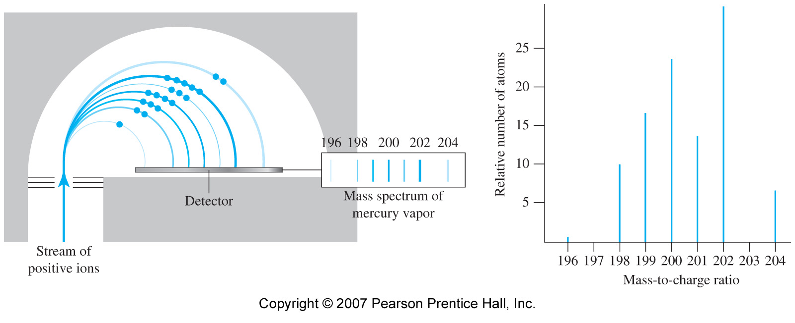
A mass spectrometer and a mass spectrum
Must determine atomic mass experimentally:
Mass Spectrometer
Atomic mass of Hg = 200.59u
Figure 2-14
General Chemistry: Chapter 2
Copyright © 2011 Pearson Canada Inc.

Slide 10
Example
Masses of atoms are determined experimentally using mass spectrometer
Mass of ¹²C is defined as 12 u
Experimentally:
Ratio of Mass of ¹⁶O to ¹²C is 1.33291
Thus: Mass of ¹⁶O = 1.33291 x 12u = 15.9949u
General Chemistry: Chapter 2
Copyright © 2011 Pearson Canada Inc.

Slide 11
Example
The two naturally occurring isotopes of Boron are:
¹⁰B and ¹¹B with masses 10.0129370 u and 11.0093054 u, respectively.
Which of these occurs in greater abundance?
Slide <number> of 27
General Chemistry: Chapter 2
Copyright © 2011 Pearson Canada Inc.

Slide 12
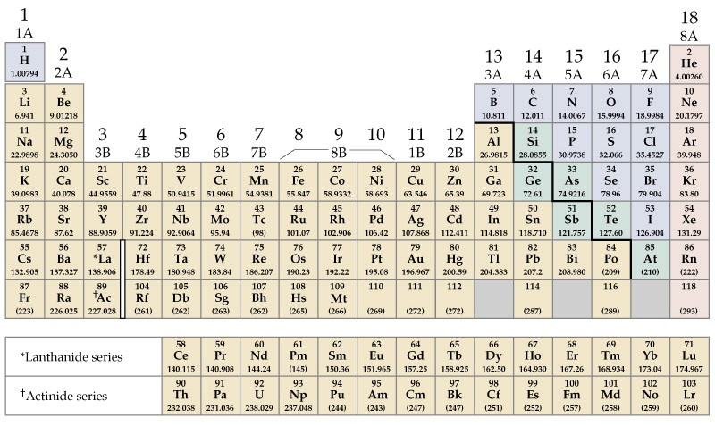
The Periodic table
General Chemistry: Chapter 2
Copyright © 2011 Pearson Canada Inc.

Slide 13
The Periodic table
Elements are organized according to observable properties:
Density, melting point, electrical conductivity, chemical reactivity, etc.
Elements are listed according to increased atomic mass in horizontal rows (periods)
Similar elements line up in columns (groups)
Each element’s symbol with the Z value and Mass value are given in each square
Obvious properties: metals and non-metals (metalloids)
Some elements are gases, most are solids (2 are liquid)
6th and 7th period have 32 elements. Normal PT includes only 18 periods. Additional 14 elements are listed separately: Lanthanides & Actinides

Slide 14
The Periodic table
Alkali Metals
Noble Gases
Alkaline Earths
Main Group
Halogens
Transition Metals
Main Group
Lanthanides and Actinides
General Chemistry: Chapter 2
Copyright © 2011 Pearson Canada Inc.

Slide 15
The Concept of the Mole
Physically counting atoms is impossible.
We must be able to relate measured mass to numbers of atoms.
buying nails by the pound or kilogram
  using atoms by the gram
Law of multiple proportions: (Dalton)
compounds combine elements whose mass rations are in small whole numbers
compounds are groups of atoms combined in small whole numbers
Must relate the measured (macroscopic) mass to the atomic mass
The Mole
General Chemistry: Chapter 2
Copyright © 2011 Pearson Canada Inc.

Slide 16
Concept of the Mole and Avogadro constant, N_{A}
The mole is an amount of substance that contains the same number of elementary entities (N_{A}) as there are carbon-12 atoms in exactly 12 g of carbon-12.
1 mole of C is defined as 12 g of ¹²C
12 g/mol of ¹²C = N_{A} x (mass of 1 atom of ¹²C) g
Experimentally: mass of 1 atom of ¹²C in g = 1.9926 x 10 ⁻²³ g
N_{A} =
N_{A} = 6.02214179 x 10²³ mol⁻¹
General Chemistry: Chapter 2
Copyright © 2011 Pearson Canada Inc.

Slide 17
Concept of the Mole and Avogadro constant, N_{A}
We can define a mole of any entity:
an element (atoms)
a compound (molecules)
other particles (electrons, etc.)
One mole of O is the atomic mass of O in grams:
One mole of O contains N_{A} of O atoms
One mole of H₂O (water) is the molecular mass of water in grams:
One mole of water contains
General Chemistry: Chapter 2
Copyright © 2011 Pearson Canada Inc.

Slide 18
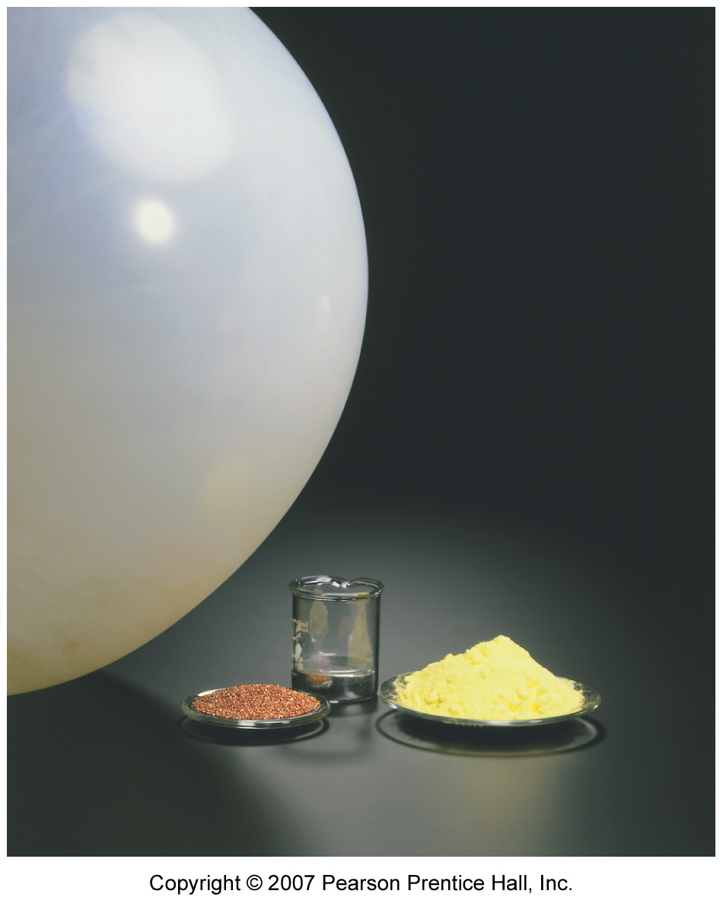
One mole of an element
One mole of He atoms
One mole of Hg atoms
One mole of S atoms
One mole of Cu atoms
Figure 2-17
General Chemistry: Chapter 2
Copyright © 2011 Pearson Canada Inc.
Notes:
Chemistry 140 Fall 2002

Slide 19
Example
In 4.07 g of S:
How many moles of S
How many atoms of S

Slide 20
Example
What is the mass of 2.35 x 10²⁴ atoms of Cu?
1) How many moles do we have?
2) Since one mole weighs 63.546 g

